Slide 1

CHAPTER 4
ELEMENTARY NUMBER THEORY AND METHODS OF PROOF
Copyright © Cengage Learning. All rights reserved.

Slide 2

4.3
Direct Proof and Counterexample Ⅲ: Rational Numbers
Copyright © Cengage Learning. All rights reserved.

Slide 3
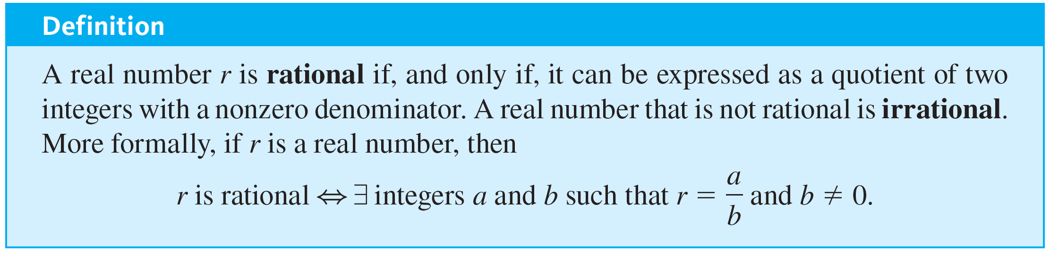
Direct Proof and Counterexample Ⅲ: Rational Numbers

Slide 4

Example 4.3.1 – Determining Whether Numbers Are Rational or Irrational
a. Is 10 ∕ 3 a rational number?
b. Is
a rational number?
c. Is 0.281 a rational number?
d. Is 7 a rational number?
e. Is 0 a rational number?
f. Is 2 ∕ 0 a rational number?
g. Is 2 ∕ 0 an irrational number?

Slide 5
Example 4.3.1 – Determining Whether Numbers Are Rational or Irrational
continued
h. Is 0.12121212… a rational number (where the digits 12 are assumed to repeat forever)?
i. If m and n are integers and neither m nor n is zero, is (m + n) ∕ mn a rational number?

Slide 6

Example 4.3.1 – Solution
a. Yes, 10 ∕ 3 is a quotient of the integers 10 and 3 and hence is rational.
b. Yes,
which is a quotient of the integers −5 and 39 and hence is rational.
c. Yes, 0.281 = 281 ∕ 1000. Note that the numbers shown on a typical calculator display are all finite decimals. An explanation similar to the one in this example shows that any such number is rational.
It follows that a calculator with such a display can accurately represent only rational numbers.

Slide 7
Example 4.3.1 – Solution
continued
d. Yes, 7 = 7 ∕ 1.
e. Yes, 0 = 0 ∕ 1.
f. No, 2 ∕ 0 is not a real number (division by 0 is not allowed).
g. No, because every irrational number is a real number, and 2 ∕ 0 is not a real number.

Slide 8

Example 4.3.1 – Solution
continued
h. Yes. Let x = 0.12121212… Then 100x = 12.12121212…
Thus
100x − x = 12.12121212…− 0.12121212… = 12.
But also 100x − x = 99x by basic algebra.
Hence 99x = 12,
and so
Therefore, 0.12121212… = 12 ∕ 99, which is a ratio of two nonzero integers and thus is a rational number.

Slide 9
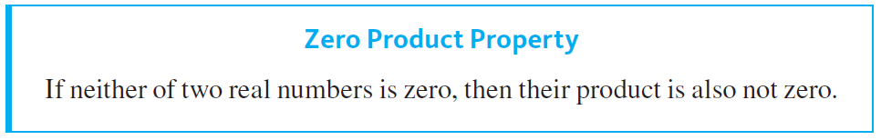
Example 4.3.1 – Solution
continued
Note that you can use an argument similar to this one to show that any repeating decimal is a rational number.
i. Yes, since m and n are integers, so are m + n and mn (because sums and products of integers are integers). Also mn ≠ 0 by the zero product property.
One version of this property says the following:

Slide 10
More on Generalizing from the Generic Particular

Slide 11
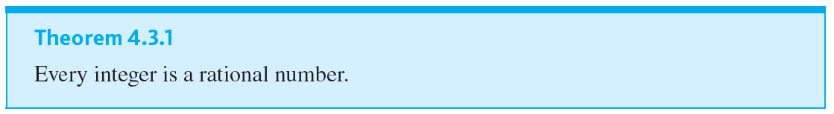
More on Generalizing from the Generic Particular
Most problems are stated in informal language, but solving them often requires translating them into more formal terms.

Slide 12
Proving Properties of Rational Numbers

Slide 13
Example 4.3.2 – Any Sum of Rational Numbers Is Rational
Prove that the sum of any two rational numbers is rational.

Slide 14
Example 4.3.2 – Solution
Begin by mentally or explicitly rewriting the statement to be proved in the form
Formal Restatement: ∀ real numbers r and s, if r and s are rational then r + s is rational.
Next ask yourself, “Where am I starting from?” or “What am I supposing?” The answer gives you the starting point, or first sentence, of the proof.

Slide 15
Example 4.3.2 – Solution
continued
Starting Point: Suppose r and s are any particular but arbitrarily chosen real numbers such that r and s are rational; or, more simply,
Suppose r and s are any rational numbers.
Then ask yourself, “What must I show to complete the proof?”
To Show: r + s is rational.
Finally ask, “How do I get from the starting point to the conclusion?” or “Why must r + s be rational if both r and s are rational?” The answer depends in an essential way on the definition of rational.

Slide 16
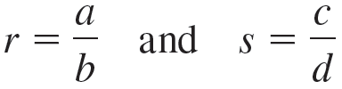

Example 4.3.2 – Solution
continued
Rational numbers are quotients of integers, so to say that r and s are rational means that
for some integers a, b, c, and d where b ≠ 0 and d ≠ 0.
It follows by substitution that
(4.3.1)

Slide 17
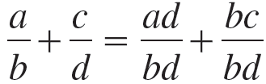
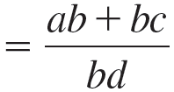
Example 4.3.2 – Solution
continued
You need to show that r + s is rational, which means that r + s can be written as a single fraction or ratio of two integers with a nonzero denominator.
But the right-hand side of equation (4.3.1) is
by rewriting the fraction with a common
denominator
by adding fractions with a
common denominator.

Slide 18
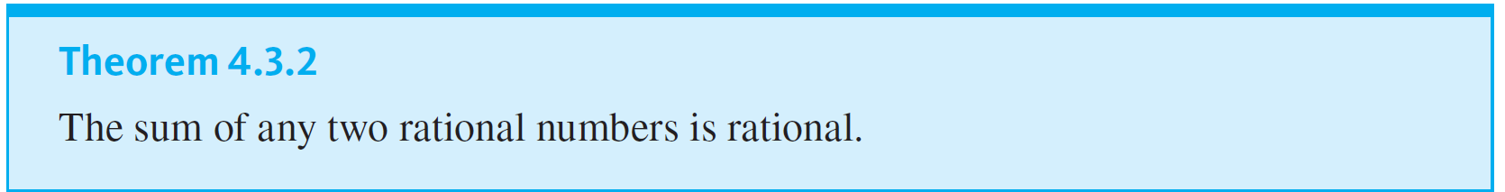
Example 4.3.2 – Solution
continued
Is this fraction a ratio of integers? Yes. Because products and sums of integers are integers, ad + bc and bd are both integers.
Is the denominator bd ≠ 0? Yes, by the zero product property (since b ≠ 0 and d ≠ 0). Thus r + s is a rational number.

Slide 19
Deriving New Mathematics from Old

Slide 20
Example 4.3.3 – Deriving Additional Results about Even and Odd Integers
Suppose that you have already proved the following properties of even and odd integers:
1. The sum, product, and difference of any two even integers are even.
2. The sum and difference of any two odd integers are even.
3. The product of any two odd integers is odd.
4. The product of any even integer and any odd integer is even.

Slide 21
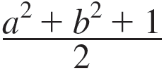
Example 4.3.3 – Deriving Additional Results about Even and Odd Integers
continued
5. The sum of any odd integer and any even integer is odd.
6. The difference of any odd integer minus any even integer is odd.
7. The difference of any even integer minus any odd integer is odd.
Use the properties listed above to prove that if a is any even integer and b is any odd integer, then
is an integer.

Slide 22







Example 4.3.3 – Solution
Suppose a is any even integer and b is any odd integer. By property 3,
is odd, and by property 1,
is even. Then by property 5,
is odd, and because 1 is also odd, the sum
is even by property 2.
Hence, by definition of even, there exists an integer k such that
which is an integer. Thus
Dividing both sides by 2 gives
is an integer.

Slide 23
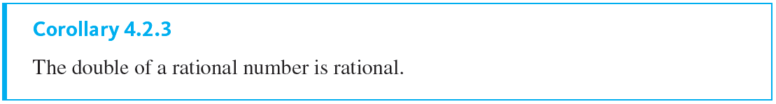
Example 4.3.4 – The Double of a Rational Number
Derive the following as a corollary of Theorem 4.3.2.

Slide 24
Example 4.3.4 – Solution
The double of a number is just its sum with itself. But since the sum of any two rational numbers is rational (Theorem 4.3.2), the sum of a rational number with itself is rational.
Hence the double of a rational number is rational. Here is a formal version of this argument:
Proof: Suppose r is any rational number. Then 2r = r + r is a sum of two rational numbers. So, by Theorem 4.3.2, 2r is rational.

